Slide 1
INTRODUCTION TO COMPUTING
Course Code: CCINCOM/L
Hash Tables
Joseph Marvin R. Imperial
Faculty
Department of Computer Science
College of Computing and Information Technologies (CCIT)
National University
Joseph Marvin R. Imperial
DATA STRUCTURES AND ALGORITHMS
NU College of Computing and Information Technologies
Course Code: CCDATRCL

Slide 2
Hash Tables
A hash table is basically an array that links a key to a specific data value.
Why array? Because of fast indexing of values.
Joseph Marvin R. Imperial
DATA STRUCTURES AND ALGORITHMS
NU College of Computing and Information Technologies
Course Code: CCDATRCL

Slide 3
Scenario
Assume that you have an object and you want to assign a key to it to make searching easy. However, in cases where the keys are large and cannot (ex. string) be used directly as an index.
For this problem you should use hashing.
Joseph Marvin R. Imperial
DATA STRUCTURES AND ALGORITHMS
NU College of Computing and Information Technologies
Course Code: CCDATRCL

Slide 4
Examples
In universities, each student is assigned a unique roll (key) number that can be used to retrieve information (value) about them like addresses, course, etc.
In libraries, each book is assigned a unique number (key) that can be used to determine information (value) about the book, such as its exact position in the library or the users it has been issued to etc.
Joseph Marvin R. Imperial
DATA STRUCTURES AND ALGORITHMS
NU College of Computing and Information Technologies
Course Code: CCDATRCL

Slide 5
Question
How do we actually go about placing this data structure on top of an array? The indexes of the slots in an array are whole numbers, not string. How do we do it?
Enter the hash function.
Joseph Marvin R. Imperial
DATA STRUCTURES AND ALGORITHMS
NU College of Computing and Information Technologies
Course Code: CCDATRCL

Slide 6
Hash functions
We use hash functions to turn the keys into integers to serve as indices of an array. The values are then stored in a data structure called hash table.
This integer generated will always be associated to the string input no matter how many times you put the same string through the function.
hash function f(x)
key
integer
Joseph Marvin R. Imperial
DATA STRUCTURES AND ALGORITHMS
NU College of Computing and Information Technologies
Course Code: CCDATRCL

Slide 7
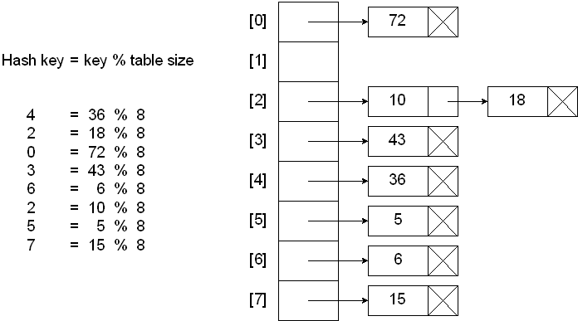
Hash table example (integer key)
Joseph Marvin R. Imperial
DATA STRUCTURES AND ALGORITHMS
NU College of Computing and Information Technologies
Course Code: CCDATRCL

Slide 8
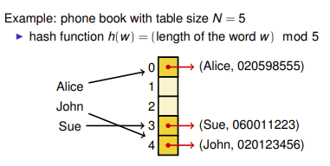
Hash table example (string key)
Joseph Marvin R. Imperial
DATA STRUCTURES AND ALGORITHMS
NU College of Computing and Information Technologies
Course Code: CCDATRCL

Slide 9
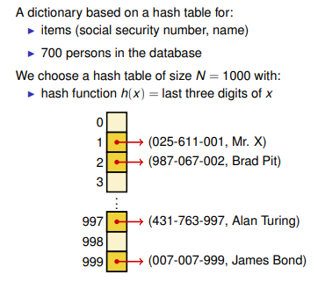
Hash table example (string key)
Joseph Marvin R. Imperial
DATA STRUCTURES AND ALGORITHMS
NU College of Computing and Information Technologies
Course Code: CCDATRCL

Slide 10
Hash functions: can I create my own?
A hash function is any function that can be used to map a data set of an arbitrary size to a data set of a fixed size, which falls into the hash table.
The values returned by a hash function are called hash values, hash codes, hash sums, or simply hashes.
Common hash functions the convention below:
hash = f(key)
index = hash % array_size
Joseph Marvin R. Imperial
DATA STRUCTURES AND ALGORITHMS
NU College of Computing and Information Technologies
Course Code: CCDATRCL

Slide 11
Hash functions: goals
The idea of hashing is to distribute key and value pairs uniformly across an array.
By using that key you can access the element in O(1) time or constant time (very fast).
Joseph Marvin R. Imperial
DATA STRUCTURES AND ALGORITHMS
NU College of Computing and Information Technologies
Course Code: CCDATRCL

Slide 12
Try
Using the data set (key, value pair):
(1,20), (2,70), (42,80), (4,25), (12,44), (14,32), (17,11), (13,78), (37,98)
Create a hash table using the following hash function:
index = f(key)
where f(key) = key % 20
Joseph Marvin R. Imperial
DATA STRUCTURES AND ALGORITHMS
NU College of Computing and Information Technologies
Course Code: CCDATRCL

Slide 13
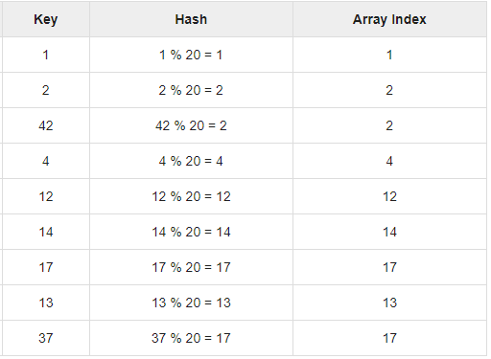
Answer
Joseph Marvin R. Imperial
DATA STRUCTURES AND ALGORITHMS
NU College of Computing and Information Technologies
Course Code: CCDATRCL

Slide 14
Problem
What if a string resulted into a duplicate hash value?
Such phenomenon is called a collision or collision problem.
Joseph Marvin R. Imperial
DATA STRUCTURES AND ALGORITHMS
NU College of Computing and Information Technologies
Course Code: CCDATRCL

Slide 15
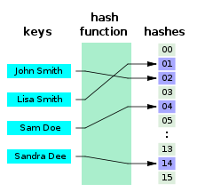
Collision problem
There could possibly be two or more pieces of keys in dataset that will hash to the same integer in the array.
Joseph Marvin R. Imperial
DATA STRUCTURES AND ALGORITHMS
NU College of Computing and Information Technologies
Course Code: CCDATRCL

Slide 16
Possible solutions to collisions
Chaining method – degrades the speed of search
Open addressing
Linear probing – makes use of extra, unused spaces
Joseph Marvin R. Imperial
DATA STRUCTURES AND ALGORITHMS
NU College of Computing and Information Technologies
Course Code: CCDATRCL

Slide 17
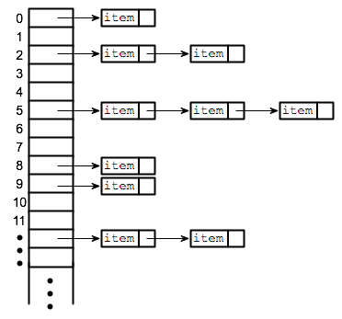
Chaining method
We could simply link the data up into a linked list at that index of the array.
Joseph Marvin R. Imperial
DATA STRUCTURES AND ALGORITHMS
NU College of Computing and Information Technologies
Course Code: CCDATRCL

Slide 18
Try
Using the data set (key,value pair):
(1,20), (2,70), (42,80), (4,25), (12,44), (14,32), (17,11), (13,78), (37,98)
Create a hash table using the following hash function:
index = f(key)
where f(key) = key % 20
This time, use chaining method to enhance hashing.
Joseph Marvin R. Imperial
DATA STRUCTURES AND ALGORITHMS
NU College of Computing and Information Technologies
Course Code: CCDATRCL

Slide 19
Question
What is the downside of using the chaining method?
Joseph Marvin R. Imperial
DATA STRUCTURES AND ALGORITHMS
NU College of Computing and Information Technologies
Course Code: CCDATRCL

Slide 20
Disadvantage of chaining method
Instead of using constant time O(1) to find a key and its corresponding information in the array, we end up needing linear time O(n) to actually walk through the linked lists to find our actual value.
Joseph Marvin R. Imperial
DATA STRUCTURES AND ALGORITHMS
NU College of Computing and Information Technologies
Course Code: CCDATRCL

Slide 21
Linear probing
Another way to deal with collisions is to “walk down” the array from the collided index until you get to the next slot that’s free.
Joseph Marvin R. Imperial
DATA STRUCTURES AND ALGORITHMS
NU College of Computing and Information Technologies
Course Code: CCDATRCL

Slide 22
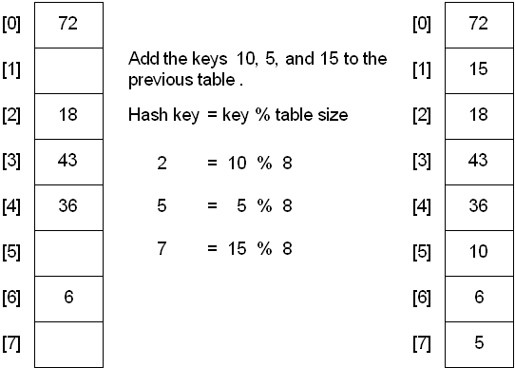
Linear probing example
Joseph Marvin R. Imperial
DATA STRUCTURES AND ALGORITHMS
NU College of Computing and Information Technologies
Course Code: CCDATRCL

Slide 23
Try
Using the data set (key,value pair):
(1,20), (2,70), (42,80), (4,25), (12,44), (14,32), (17,11), (13,78), (37,98)
Create a hash table using the following hash function:
index = f(key)
where f(key) = key % 20
This time, use linear probing to enhance hashing.
Joseph Marvin R. Imperial
DATA STRUCTURES AND ALGORITHMS
NU College of Computing and Information Technologies
Course Code: CCDATRCL

Slide 24
How to create a good hash function?
To achieve a good hashing mechanism, It is important to have a good hash function with the following basic requirements:
Easy to compute: It should be easy to compute and must not become an algorithm in itself.
Uniform distribution: It should provide a uniform distribution across the hash table and should not result in clustering.
Less collisions: Collisions occur when pairs of elements are mapped to the same hash value. These should be avoided.
Joseph Marvin R. Imperial
DATA STRUCTURES AND ALGORITHMS
NU College of Computing and Information Technologies
Course Code: CCDATRCL

Slide 25
Hash table operations
search() − Searches an element in a hash table.
insert() − inserts an element in a hash table.
delete() − Deletes an element from a hash table.
Joseph Marvin R. Imperial
DATA STRUCTURES AND ALGORITHMS
NU College of Computing and Information Technologies
Course Code: CCDATRCL

Slide 26
HashTable vs HashSet vs HashMap
HashSet is implementation of Set Interface. Used for storing objects. Does not allow duplicate values.
HashMap is an implementation of Map Interface. Used of mapping a key to value. Duplicate values are allowed, duplicate keys are not allowed.
Hashtable is a legacy class that should be avoided in favor of HashMap. An old feature.
Joseph Marvin R. Imperial
DATA STRUCTURES AND ALGORITHMS
NU College of Computing and Information Technologies
Course Code: CCDATRCL

Slide 27
References
Data Structures for Dummies: Hash Tables: https://medium.com/@ramyjzh/data-structures-for-dummies-hash-tables-579ddd1a4389
HackerRank Basics of Hash Tables https://www.hackerearth.com/practice/data-structures/hash-tables/basics-of-hash-tables/tutorial/
Joseph Marvin R. Imperial
DATA STRUCTURES AND ALGORITHMS
NU College of Computing and Information Technologies
Course Code: CCDATRCL

